Slide 1


Olist E-Commerce Dashboard
SAEFUL AMRI
Last data refresh:
12/24/2024 9:55:21 AM UTC
Downloaded at:
12/24/2024 9:57:49 AM UTC

Slide 2
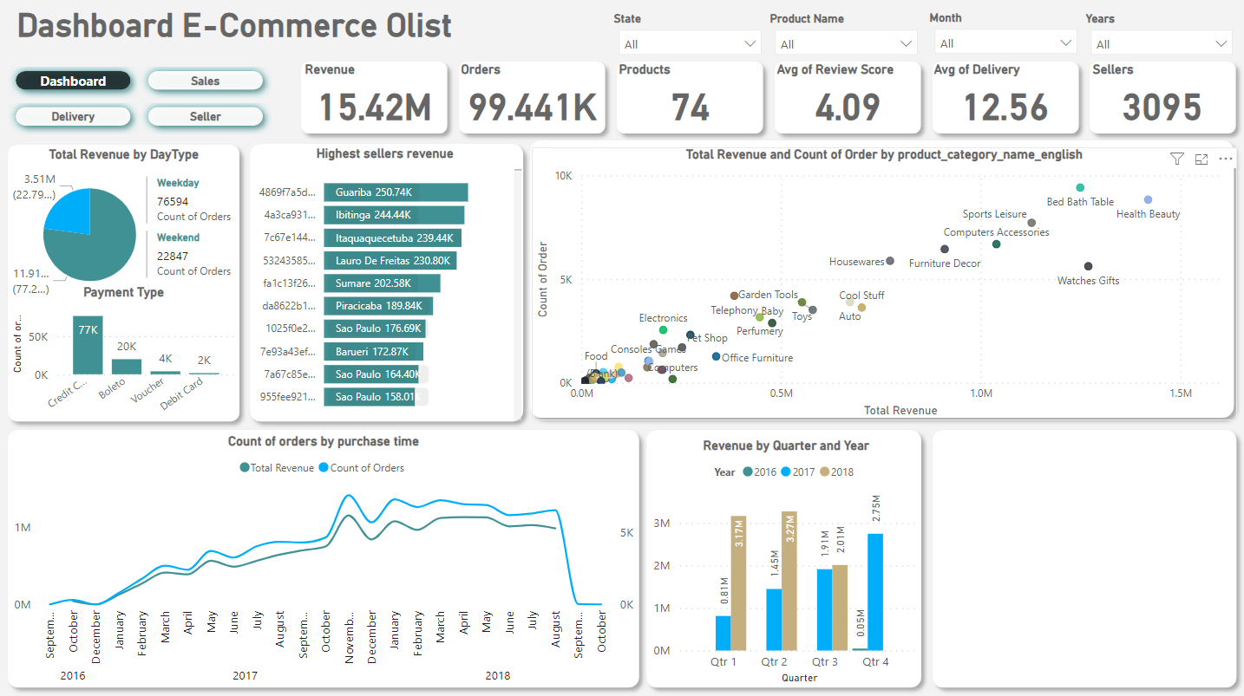
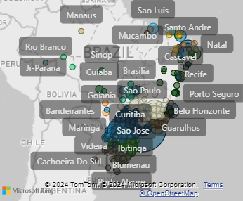

Slide 3
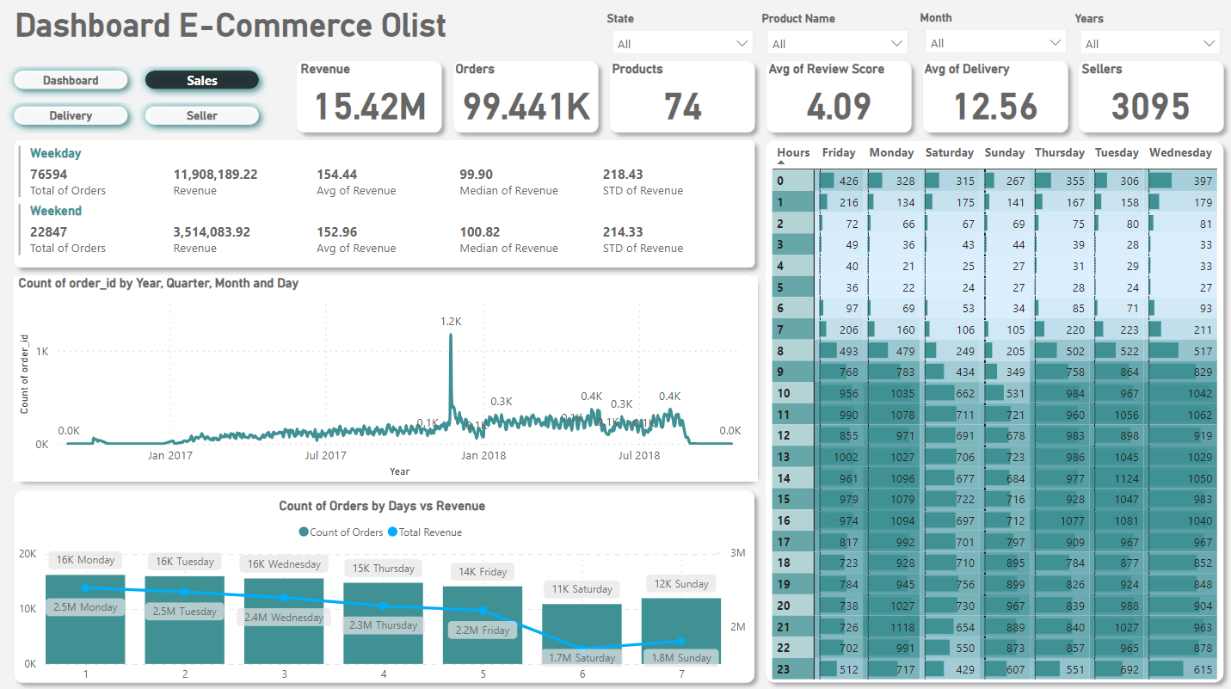

Slide 4
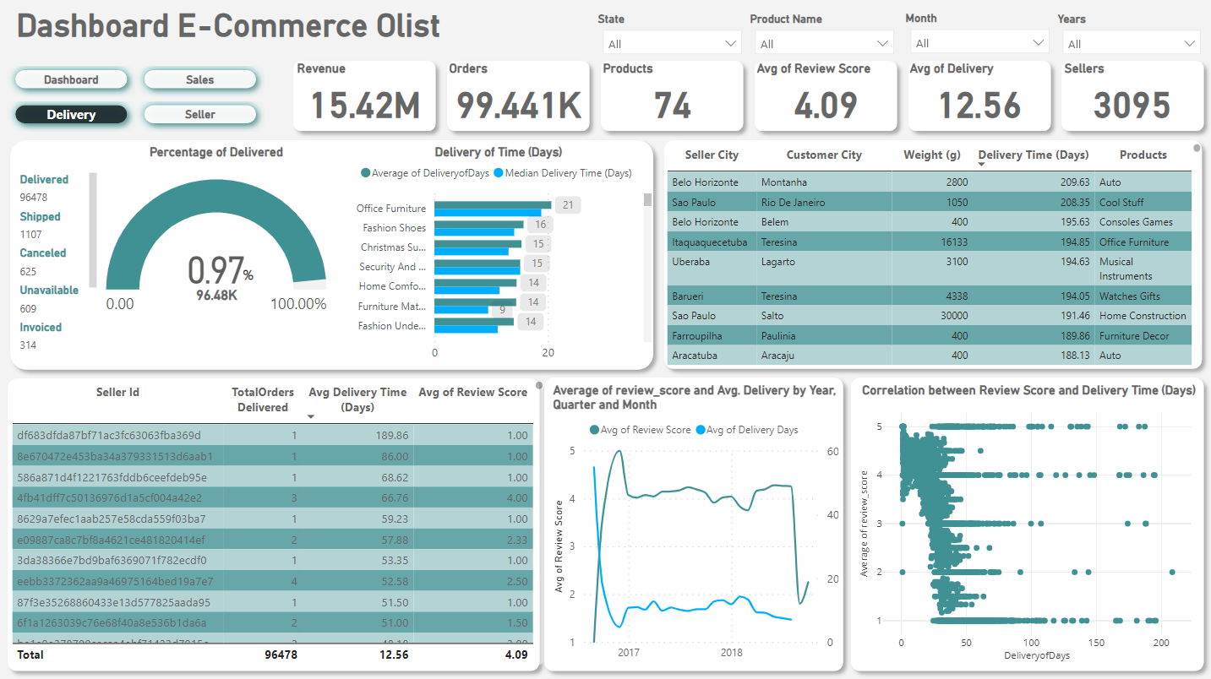

Slide 5
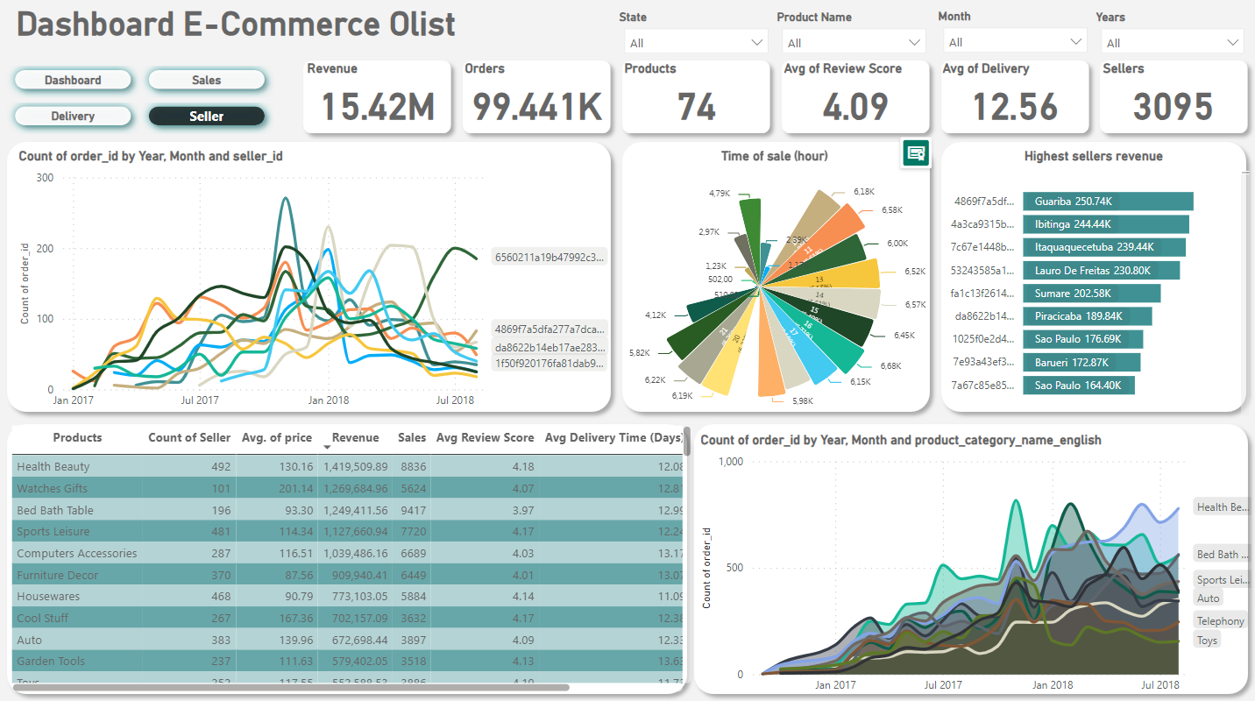

Slide 6

THANK YOU
saefulamri681@gmail.com
https://www.linkedin.com/in/saeful-amri-0a7991229/
sfl_amri_
https://github.com/Raymon360

